Slide 1
Hypothesis testing
Yuanyuan Li

Slide 2
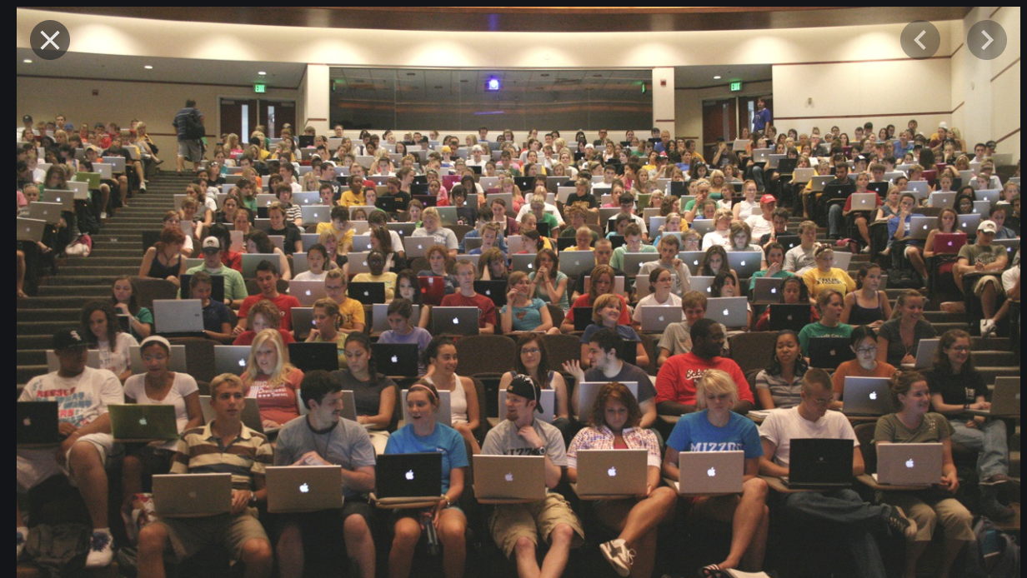
I am a TA who needs to teach 2 classes in the same room consecutively. Now this is the break between the two sections. It is quite dark here, I am wondering
Is it raining outside?

Slide 3
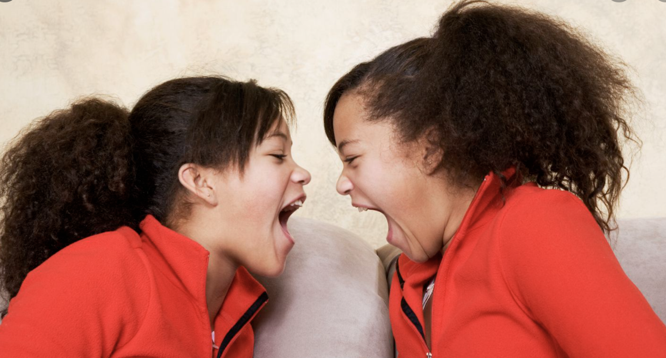
Yes, it must be raining!
No, it’s not!

Slide 4

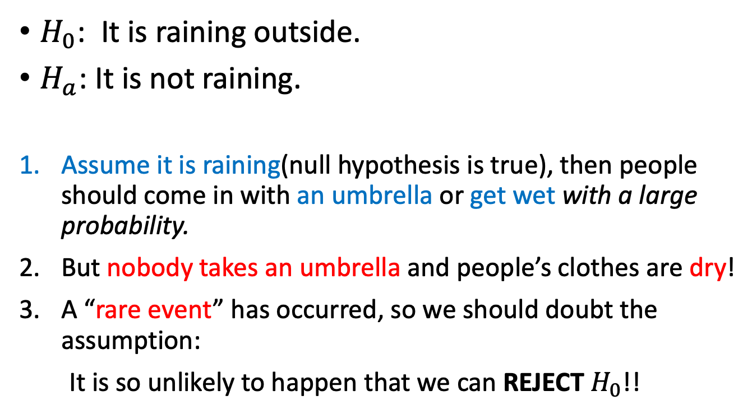
Let’s test the hypotheses!
$H_{0}$: It is raining outside.
$H_{a}$: It is not raining.
Assume it is raining(null hypothesis is true), then people should come in with an umbrella or get wet with a large probability.
But nobody takes an umbrella and people’s clothes are dry!
A “rare event” has occurred, so we should doubt the assumption:
It is so unlikely to happen that we can REJECT $H_{0}$!!

Slide 5


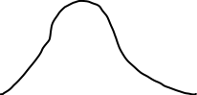
When would you reject $H_{0}$ in a test?
“rare event”:
1. For two-sided test
2. One-sided test
3. One-sided test

Slide 6
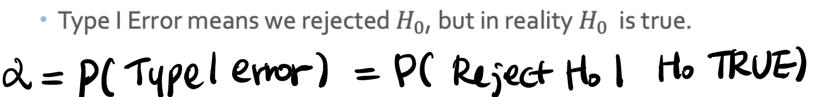
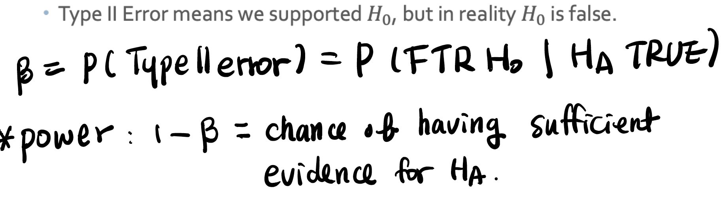
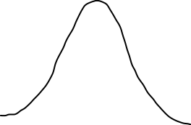




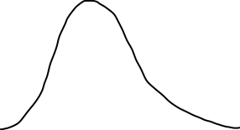
Type 1 error, Type 2 error, power of a Test

